Slide 1
Totton and Eling Town Council Draft Neighbourhood Plan

Slide 2
How Richard has reached this point:
Richard was employed by the Neighbourhood Plan team to develop the plan in February 2022. After a review of all the currently available literature including:
Consultation work completed by the Neighbourhood Plan team,
The Local Plan,
The LCWIP and previous work completed on the Transport Strategy Consultation
Discussion with NFDC’s head of Planning.
Richard has suggested the following plan:

Slide 3
Plan Proposals:
Proposal 1. Town Centre recommendations co-ordinating with NFDC and ultimately including the regeneration plan. Identification of land use in the town centre, e.g. types of community use (TBC after further public consultation.)
Proposal 2. Additional Protection and Bio-Capital Development of Green Areas within Totton and Eling. E.g. Protection of current green areas, including Bartley Water and the generation of green areas in new developments.
Proposal 3. Design Framework
Proposal 4. Active Travel routes.

Slide 4
Proposal 1. Town Centre Recommendations
based on :
Consultation work with the public through social media, contact with individual residents, visits to schools and consultation events.
Work by the Neighbourhood Plan Team
Consultants employed through Neighbourhood Plan Grant Money.

Slide 5
Initial community engagement and studies by Neighbourhood Plan Group.
Baseline assembled (literature review).
Site visits and online research.
Some further research needed.
Baseline and opportunities to be updated with new Local Plan.
Town Centre
Quick introduction

Slide 6
Geographical and focus areas:
Totton and Eling Town Council boundary.
Totton Town Centre including Rumbridge Street.
Eling Wharf and Eling.
Influences
Totton central area regeneration plan (initial work underway by NFDC).
Local Plan Parts 1 and 2
LCWIP
Town Centre
Quick introduction

Slide 7
Recommendations:
A Greener, more enjoyable town centre:
Any new development work could be based around the Civic Green and the Testvale Park in order to create a greener, more enjoyable town centre where people want to enjoy a shopping experience, take part in community activities and live.
Easier through routes for the town:
Ideally the town centre needs to be reconfigured to lead people from the shopping precinct through the civic green and up to the park area with amenities, community facilities and commercial activity taking place along the route. Easier pedestrian access around the town is also essential.
This could also include opening up the back of the precinct to community facilities or commercial premises, limiting traffic on Library Road and including busking sites, childrens town centre facilities, a town performance area or bandstand etc.

Slide 8
A welcoming town centre:
The precinct needs to be outward facing so that visitors to the town are not greeted by the backs of our main shopping area.
A vibrant town centre:
In order for the town centre to be more vibrant the current local plan designations of community use only need to be changed to include mixed use – commercial use, office use and community use. Alongside this could be buskers, town centre events, public art and street furniture that lends individuality to the town.

Slide 9
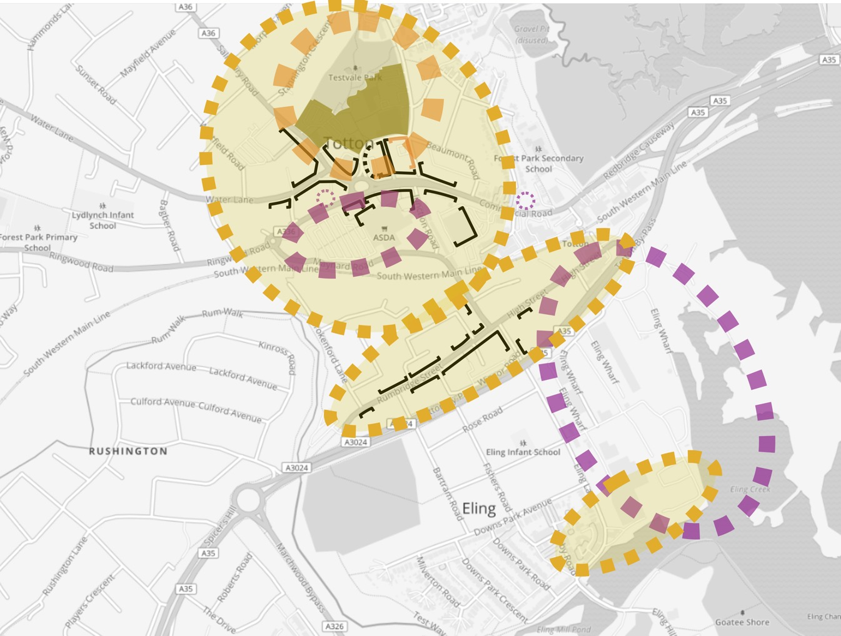
Central Totton and Eling: potential site allocations
Civic Quarter: civic led mixed use surrounding enlarged park (Local Plan).
Reconfigure shopping precinct to add retail, office and residential uses.
Eling Wharf: employment-led mixed use development including new riverside destination (cafes, culture, retail, heritage) (Local Plan).

Slide 10
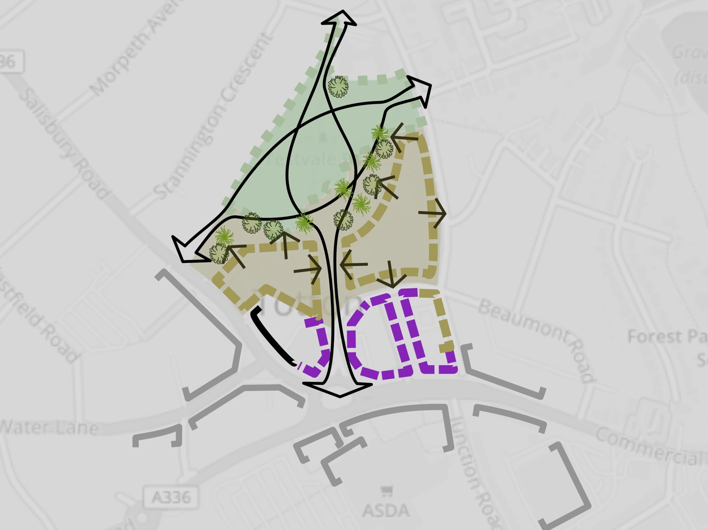
Town centre vision
A park that provides walking connections. Natural surveillance from buildings to improve personal safety. Trees to dapple views.
A new, civic-led mixed use quarter surrounding a larger Memorial Park
Drawing people into the park along a new pedestrian street lined with shops, restaurants, a market, and popular community and civic buildings

Slide 11
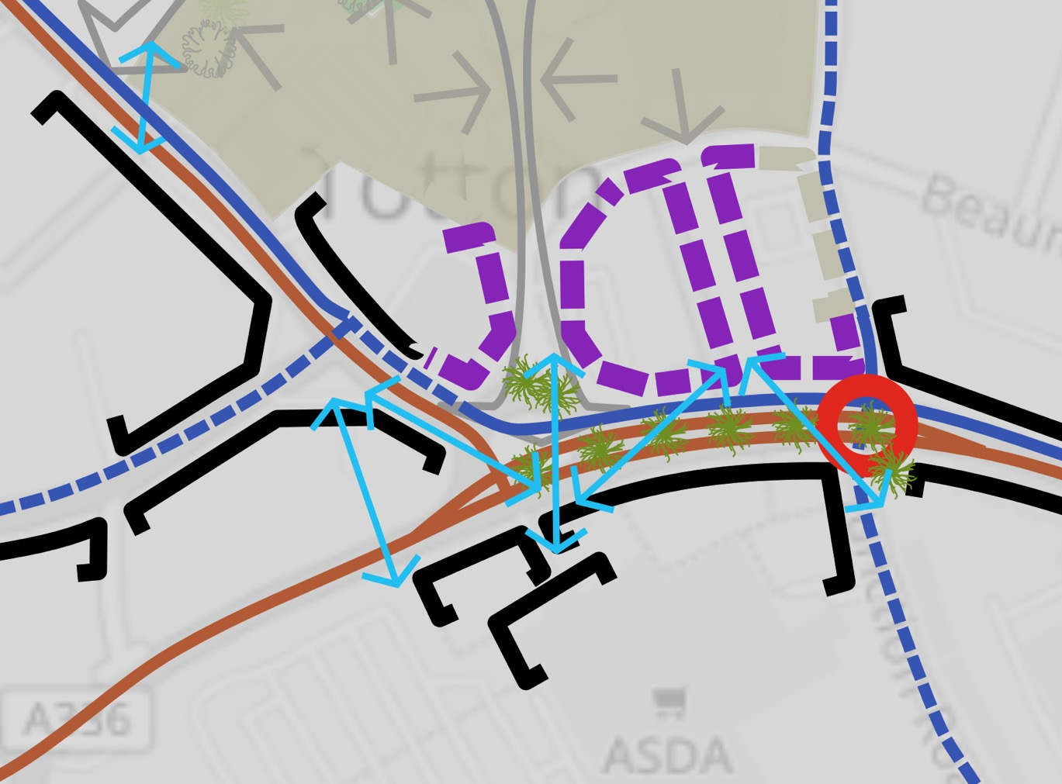
Town centre public realm
New family-friendly cycle tracks built together with wider, improved pavements.
Lots of new crossing points and links responding to where people want to walk.
Consider removing the roundabout.
Keeping a narrowed dual carriageway to make it easier to cross anywhere.
Better, safer, accessible bus stops in one place.

Slide 12
Proposal 2 Protection and Bio-Capital Development of Green Areas within Totton and Eling
Better Conservation status for the Bartley Water throughout Totton and Eling.
Enlarging green spaces within the town centre e.g. back of the library, developments to encorporate green spaces wherever possible, e.g. traffic calming with planters along Library Road.

Slide 13
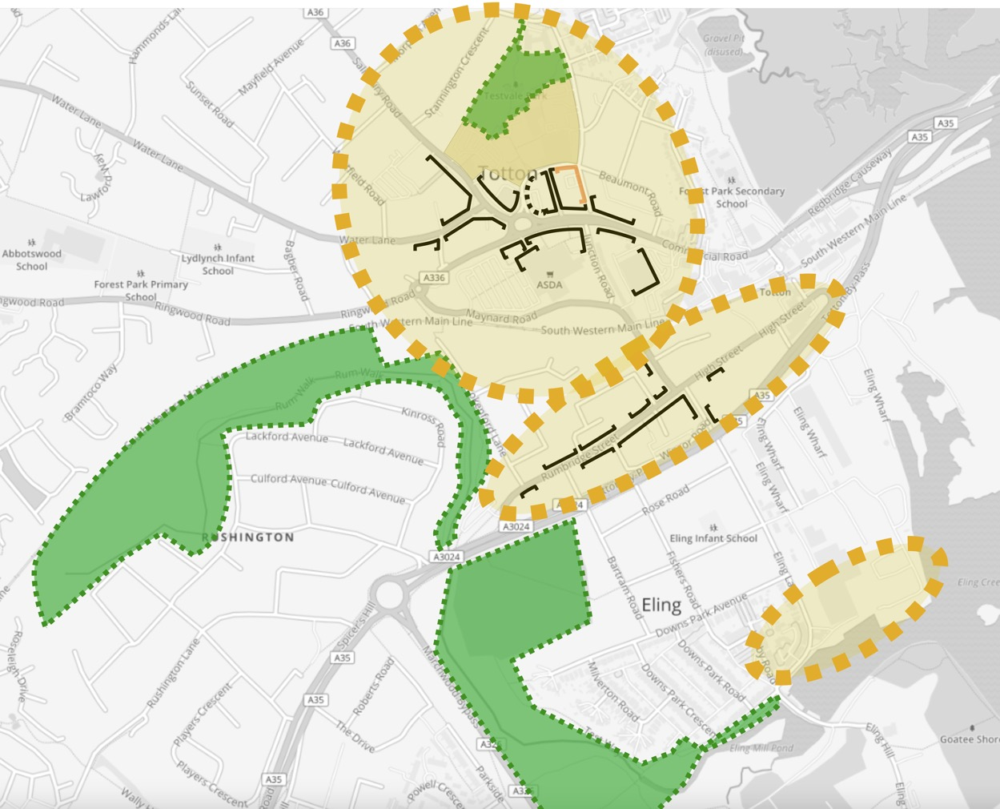
Central area green spaces
Memorial Park: larger with more connections and wrapped with high quality mixed use development.
Bartley Park: new SINC, accessible walkways.

Slide 14
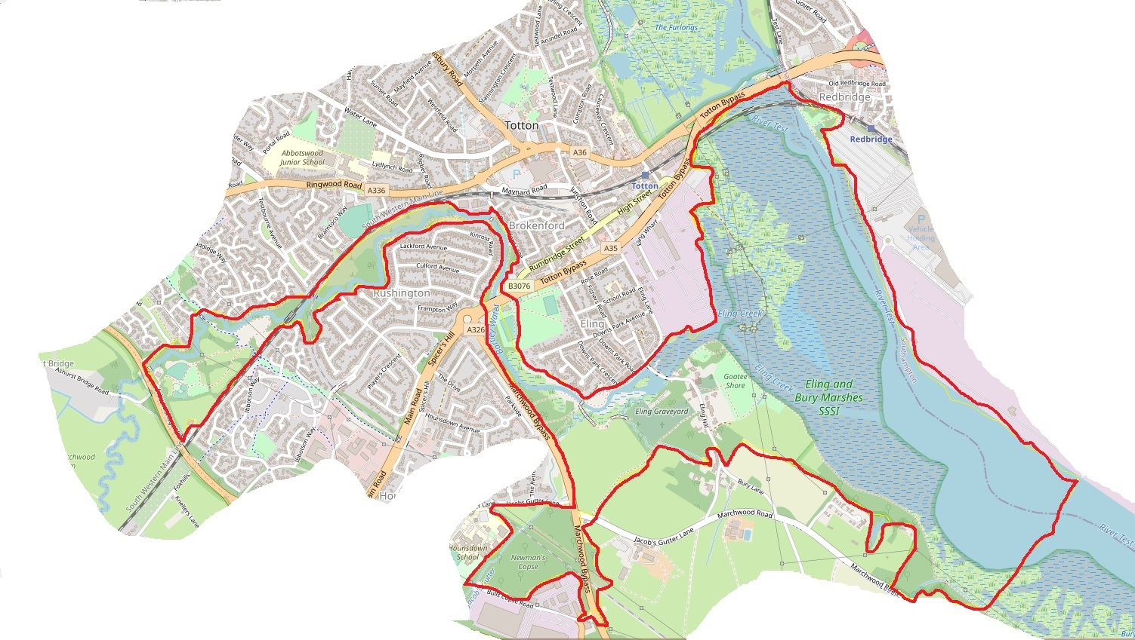

Slide 15
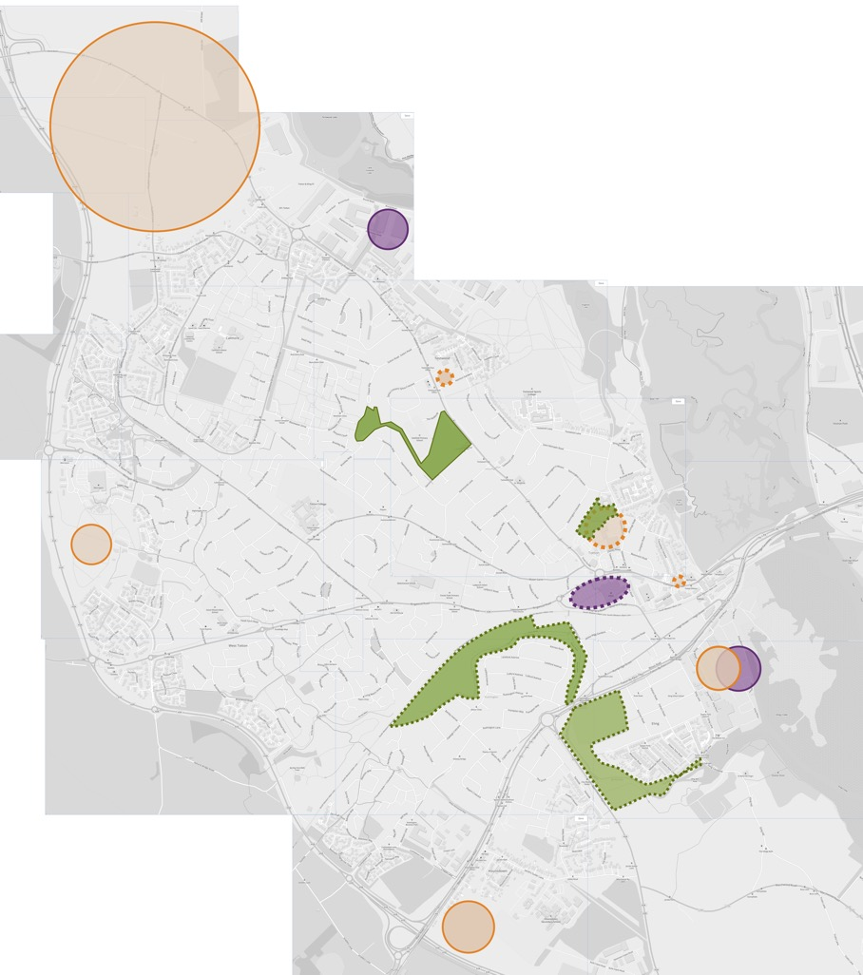
Improving our parks (infrastructure needs)
Improved public space
Trees and re-wilding.
New walking and cycling paths.
Places for sitting out and picnics.
New nature conservation
Bartley Park SINC.
Improved pedestrian access.

Slide 16
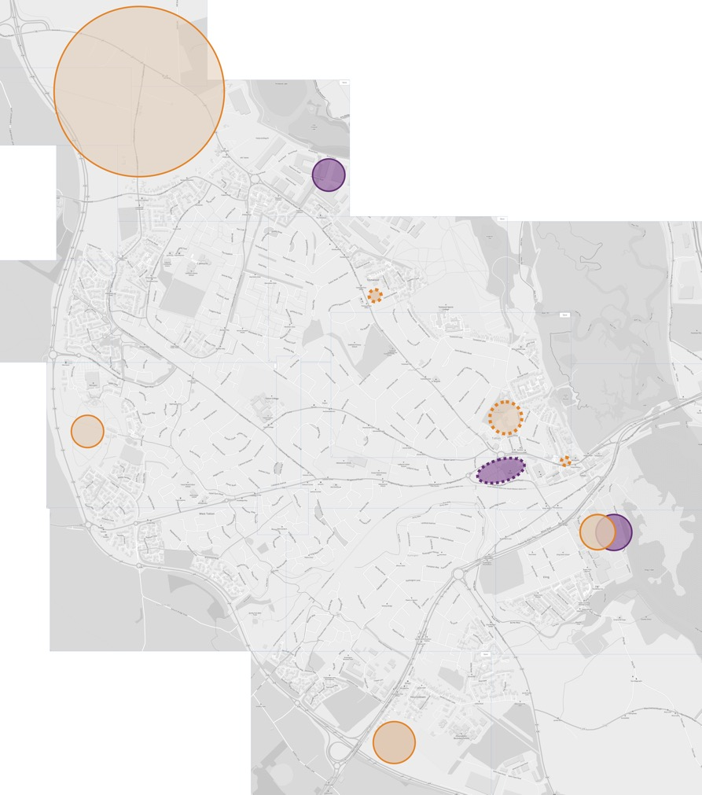
Whole town site allocations
Strategic and large sites allocated in Local Plan
May be some NP influence over design and access.
Smallest viable sites can be allocated in NP
Social housing.
Community uses.

Slide 17
Proposal 3: Design Strategy Features
The town could focus on improved environment and experience for visitors through the design strategy supplemental document, and through the superficial addition of more planting, public art etc.

Slide 18
Aims: To encourage good quality design, good access and landmark buildings for Totton and Eling.
Because Totton is not a historic town (most of Totton has been built post first world war, although parts of Eling are much older) it is possible to embrace new approaches towards distinctive architecture in a way that other local towns may not be able to do, e.g. Romsey, Winchester, Beaulieu etc. However it is important that the quality of design is maintained to develop a distinctive and local character for Totton and Eling.

Slide 19
To allow a distinctive character to develop in Totton and Eling over time
.
To retain and celebrate historic buildings within the Totton and Eling parish by listing buildings of historic interest and of architectural character specific to the town.
To allow architecture which is landmark in design.
Include public art in developments as a standard.
Making sense and making more of Totton and Eling’s attractive aspects and semi-rural location – making a theme of the tide mill and the salmon leap across Totton and Eling, making Tottons green spaces more prominent in people’s minds, promoting connected cycle and pedestrian routes.
Encouraging wayfinding and information points.

Slide 20
Street Furniture
Any street furniture (e.g. litter bins, benches etc) that goes with developments needs to promote an identity for Totton by being either:
A unique, one off design, individually designed for the development
or
a design which is part of our recommended town design
Reduce catalogue based street furniture, which all towns can easily access, so as to promote an individual identity for Totton and Eling. Where possible the town can promote local crafts workers by using them to create street furniture at a reasonable price, while also building a strong and confident identity for Totton.
Street furniture, murals, paving, building materials can all be ways of introducing colour and design into the built environment.

Slide 21
To improve the town centre and other public spaces
Encouraging busking and street theatre to animate the town centre and areas for stalls or start-up units for businesses.
Create a Totton Centre Action Team similar to those in New Milton and Eastleigh, to improve the look and aspect of the town centre, to support local business and help local people holding events.
Encourage the community to be involved in design issues by setting up a residents design forum with representatives from the local community and creative industries as well as councillors who can consider design issues.
Adequate provision for children in terms of play areas, particularly in the town centre. Totton and Eling are currently well supplied with play areas except in the town centre and there is a strong desire to retain these areas. The play furniture can be included as part of the art and culture requirement if it is individually designed by local craftsworkers and of adequate quality.

Slide 22
A series of check questions can be used to ensure a proposal fits with the Design Framework:
Does the new build improve Totton and Eling for future generations?
Is the height of the new build excessive or acceptable within the limits of landmark buildings in the area (such as St Winfreds Church)
Is the new build innovative in design?
Does the new build add a new design character for Totton?
Is the new build carbon neutral?
Is the new build sustainable in terms of source of materials, ultimate disposal of the materials and ongoing use of the building?
Does the new build contain public art?
Does the new build improve community connections?
Does the new build allow encourage better access for local residents?

Slide 23
Proposal 4: Better Active Travel Routes
Residents need to be able to more easily visit different
areas of the town and access the
town centre through active travel routes ,
with bike racks and safe bike stores available when they arrive.

Slide 24
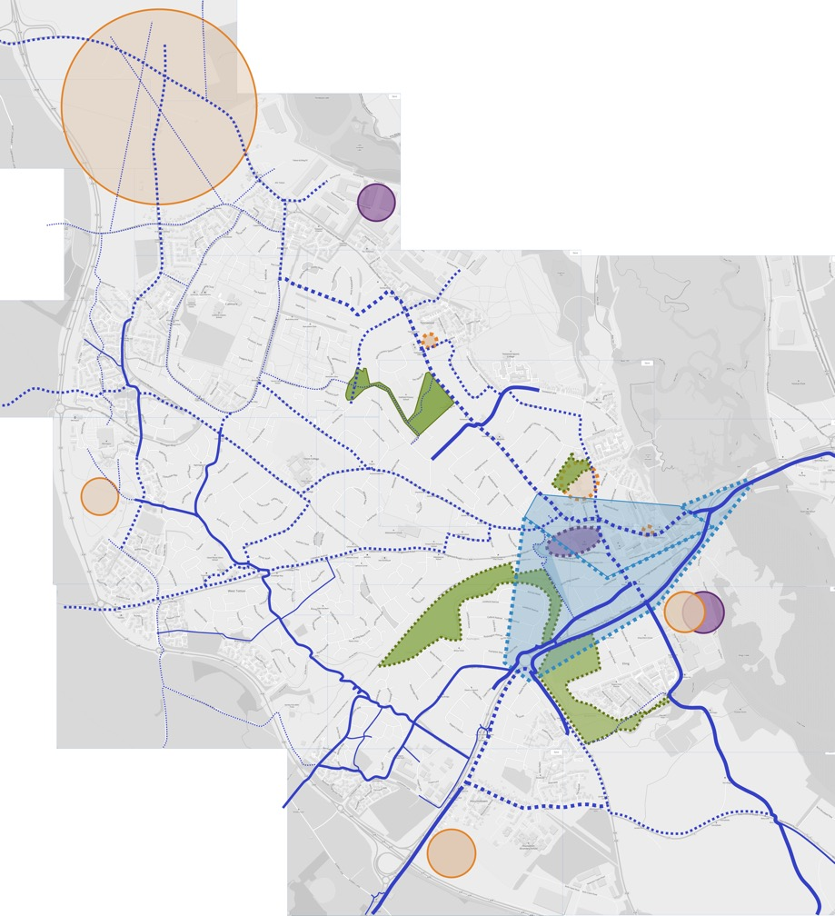
Active travel: creating a healthy, family friendly town
Town wide cycle network
Low speed residential streets.
Family friendly separate infrastructure on Salisbury Rd and Commercial Rd.
Active travel links to surrounding rural parishes.
Central area ‘core’ walking zone (expanded from Waterside Transport Strategy LCWIP).

Slide 25
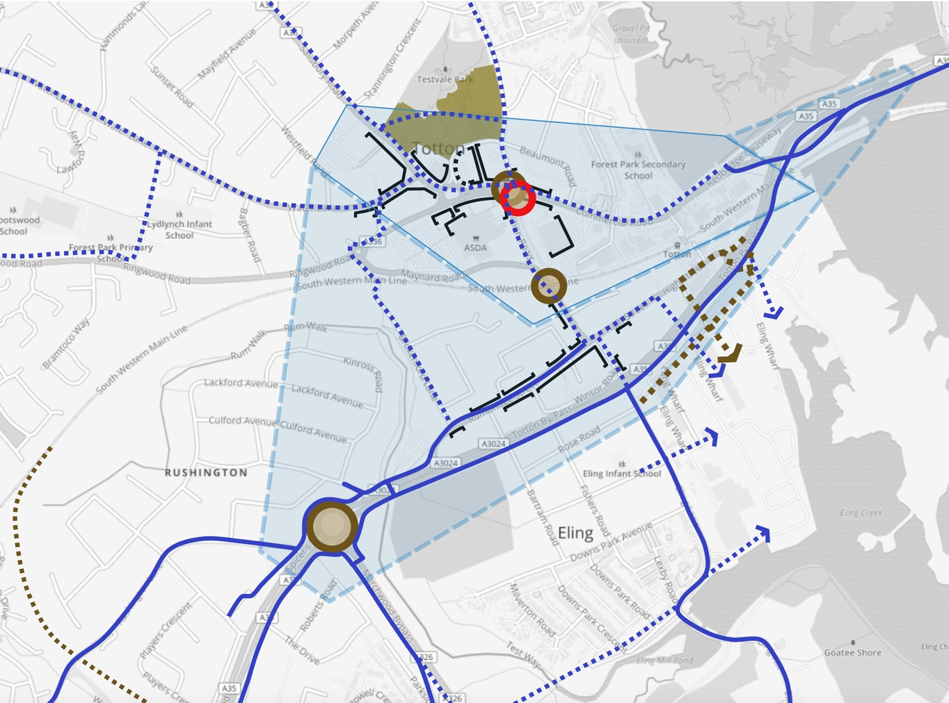
Movement
New and improved family-friendly cycleways and cycle routes.
Active travel hub in town centre.
Secure cycle storage at the station.
Cargo-bike hire.
Schools cycle parking.
Strategic
Core walking zone (extend existing zone identified in draft Waterside Transport Strategy): improved accessibility, public realm, breaking down barriers.

Slide 26
Immediate term
Apply for further funding.
Continue to update and evolve the baseline through further literature survey.
Further engagement with stakeholders.
Work with NFDC to deliver the Central Area Regeneration Plan vision we want to see.
Next steps
Future stages (outline)
Write the policies and supporting text and maps.
Further engagement.
Submit to NFDC for Examination.
Plan finished by Autumn 2022 with referendum anticipated May 2023.

Slide 27
Next steps Timetable:
Mapping evidence & opportunities – May
Participate in NFDC central area regeneration plan – July / August?
Engagement event(s) – June / July?
Start to draft last-draft policies – July-August?
Six weeks’ public consultation – September?
Finalise plan and submit to NFDC – Autumn 2022
Examination – NFDC – Early 2023
Modifications
Referendum – NFDC – May 2023.

